Slide 1
Machine Learning
Dr. Monali Mavani

Slide 2

Machine Learning
Disclaimer and Acknowledgement
The content for these slides has been obtained from books and various other source on the Internet
I here by acknowledge all the contributors for their material and inputs.
I have provided source information wherever necessary
I have added and modified the content to suit the requirements of the course

Slide 3
Session Content
Linear models for regression
Linear Regression
Linear Regression Cost Function
Learning Model Parameters - Gradient Descent Optimization
Learning Model Parameters – Closed Solution
Linear Basis Function Models
Quality of fit
Evaluation metrics

Slide 4
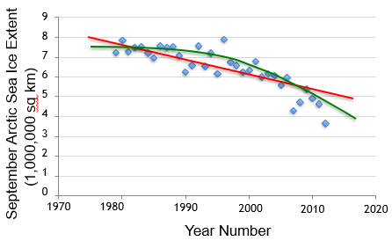
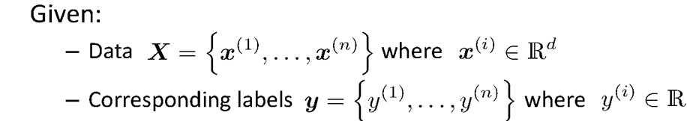
Linear Regression
Wish to learn f : X -> Y ,
For each input observation x^{(i)}, a vector of features [x₁, x₂, …,x_{n}].
j^{th} feature of i^{th} training example: x_{j} ^{(i)}

Slide 5
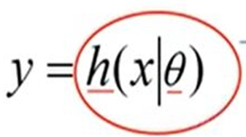

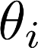
Machine Learning Process : Interpretation
Training Set
Price
(in 1000s of dollars)
Learning Algorithm
Size (feet²)
Size in feet² (x) | Price ($) in 1000's (y)
2104 | 460
1416 | 232
1534 | 315
852 | 178
… | …
Size of house
h
Estimated price
Hypothesis:
‘s : Parameters
h(.) : Model
How to choose ‘s ?

Slide 6
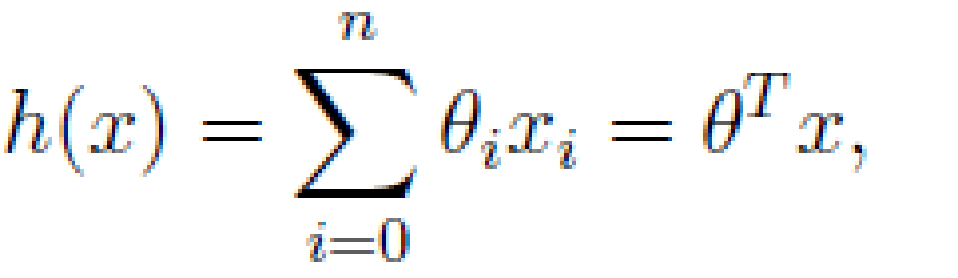
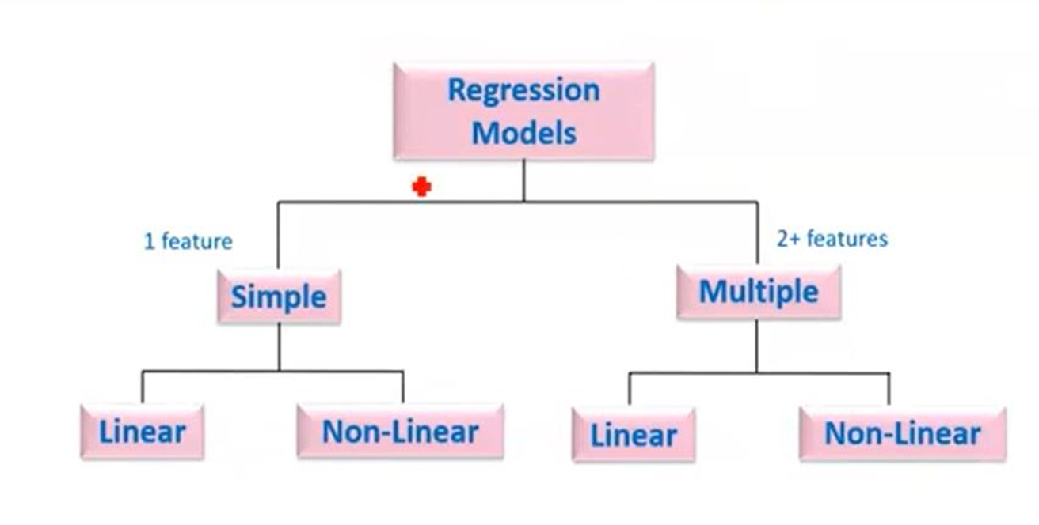
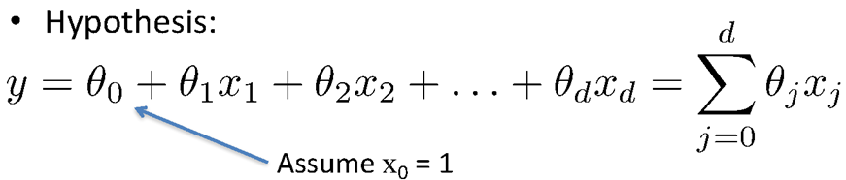
Types of Regression Models
Simple Linear regression model
(Education) x y (Income)
(Education) x₁
(Soft Skills) x₂
(Experience) x₃
(Age) x₄
Multiple Linear regression model
y (Income)

Slide 7
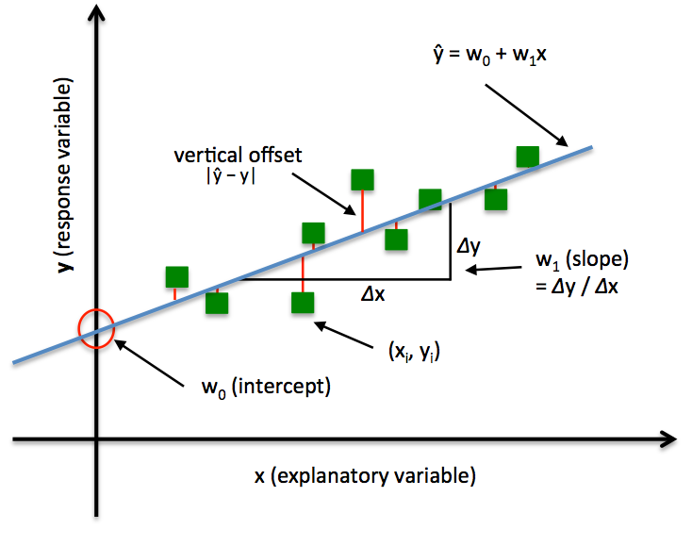
Least square regression line

Slide 9
Linear Regression – Hypothesis function

Slide 10

Learning the Model Parameters
Closed Form Solution Approach
Gradient Descent Approach

Slide 11
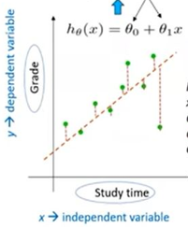
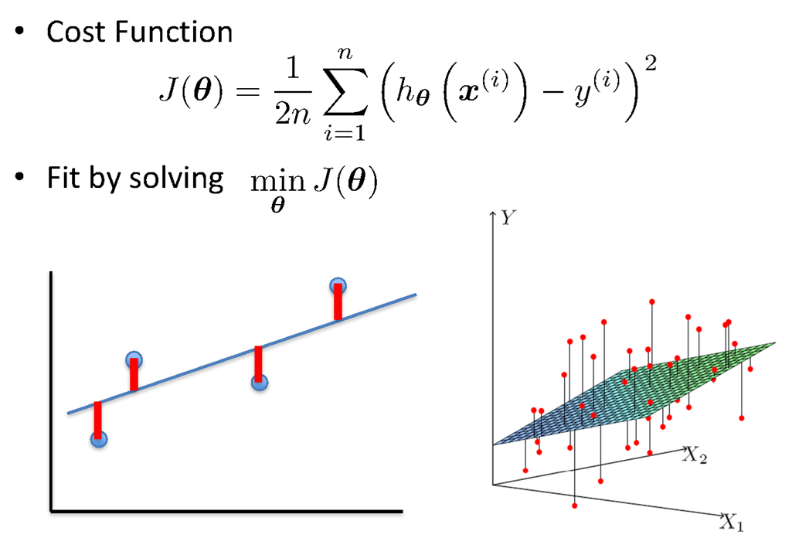
Linear Regression : Least Squares

Slide 12
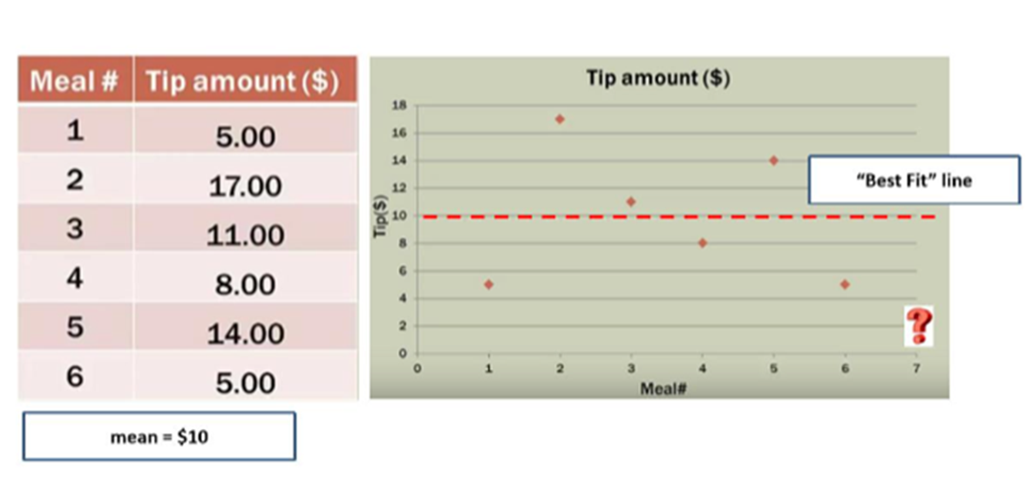
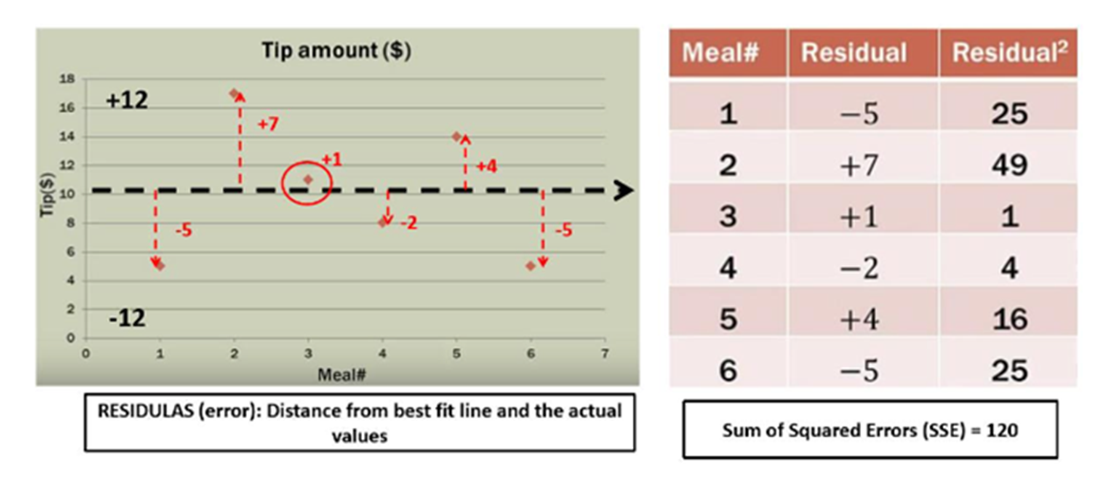
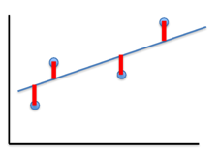
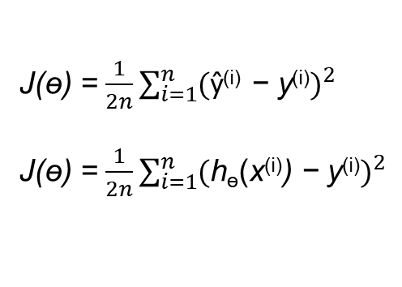
Notion of Cost Function

Slide 13
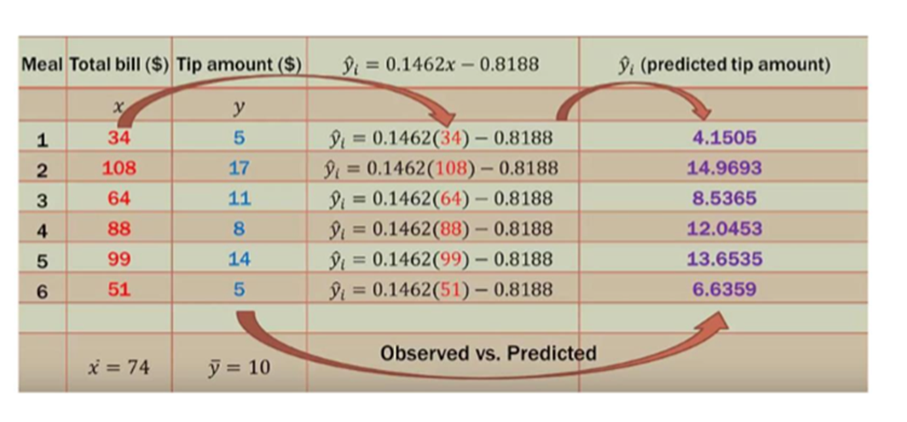
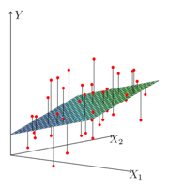
Notion of Cost Function
y = ɵ₀ + ɵ₁ x

Slide 14
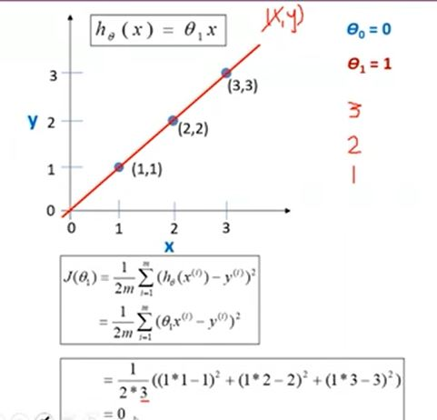
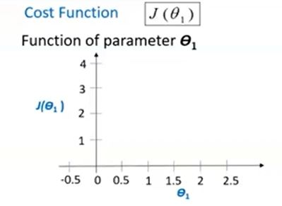
Understanding Cost Function

Slide 15
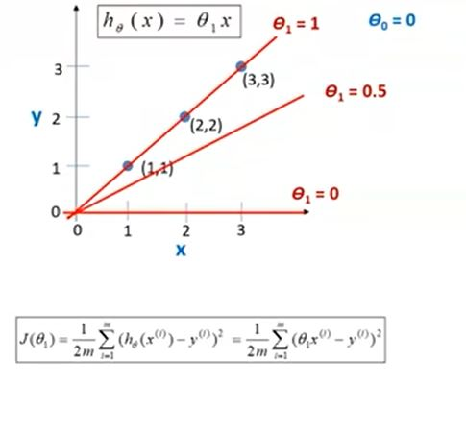
Understanding Cost Function
J(θ₁)=J(0.5)=0.58

Slide 16
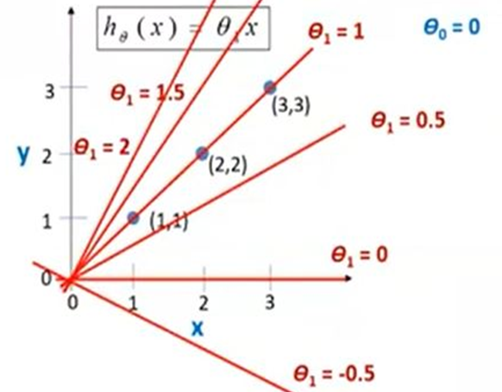
Understanding Cost Function

Slide 17
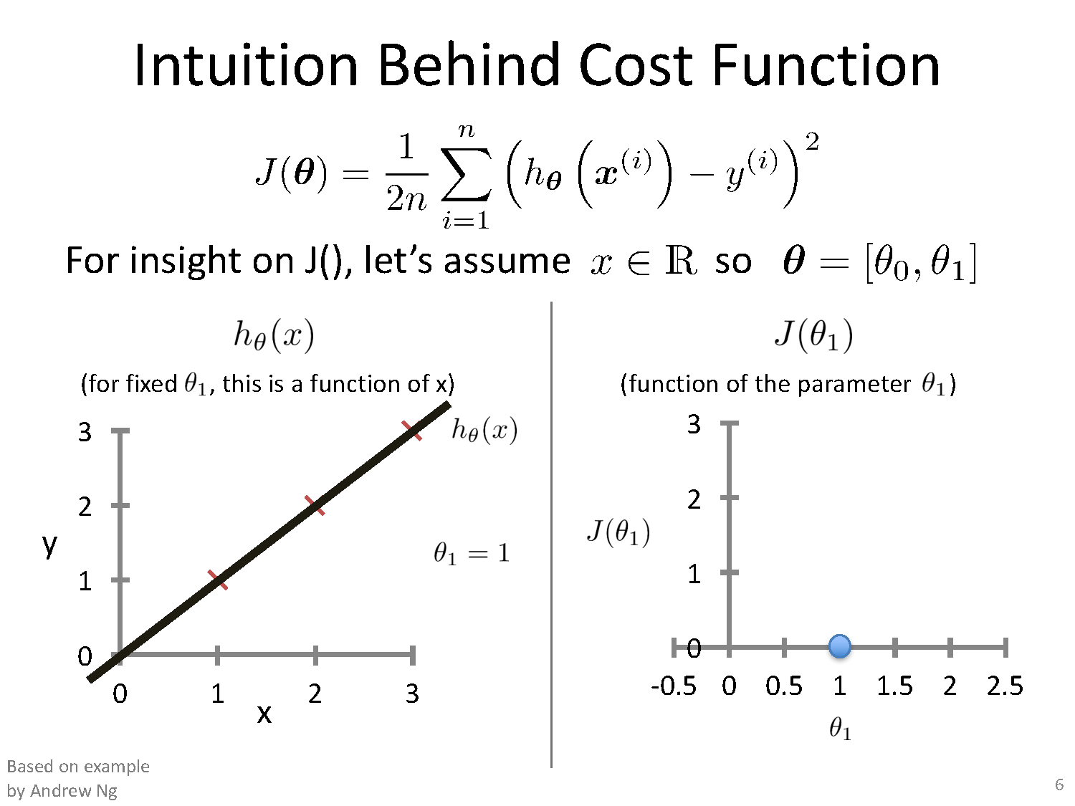
θ₀ =0

Slide 18
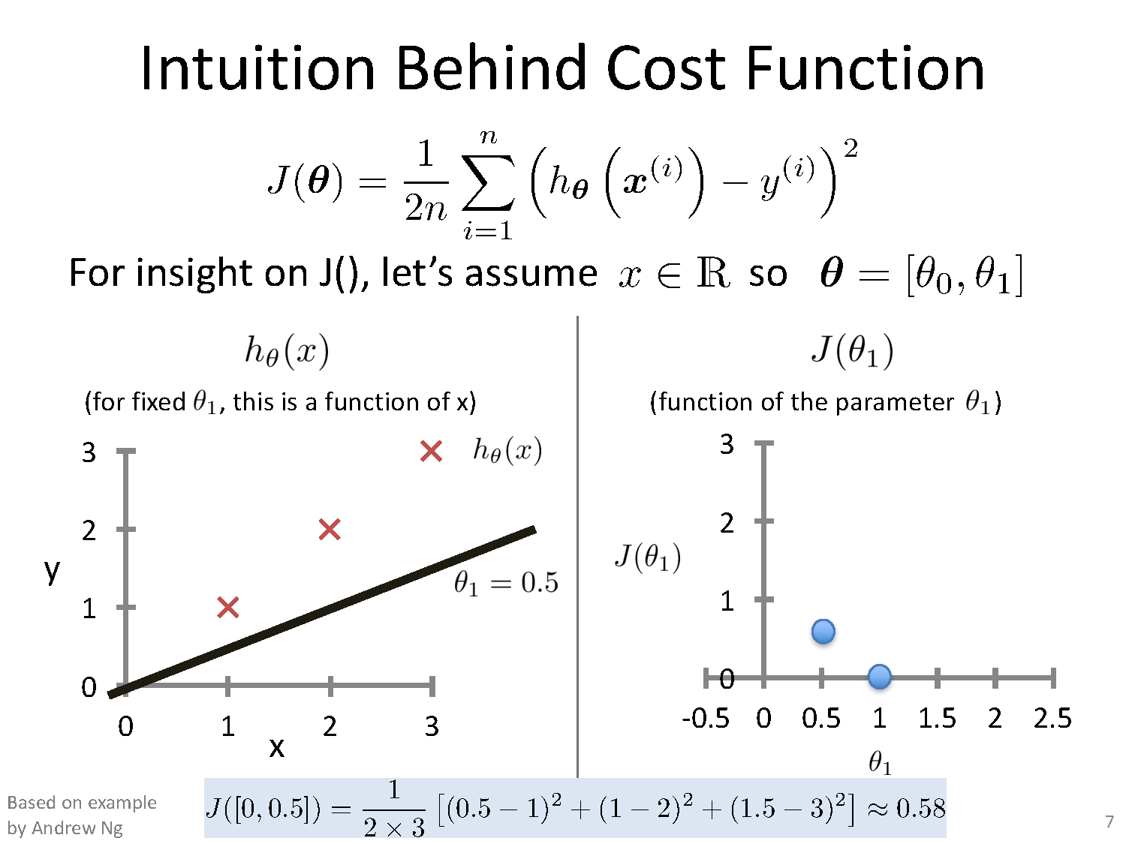

Slide 19
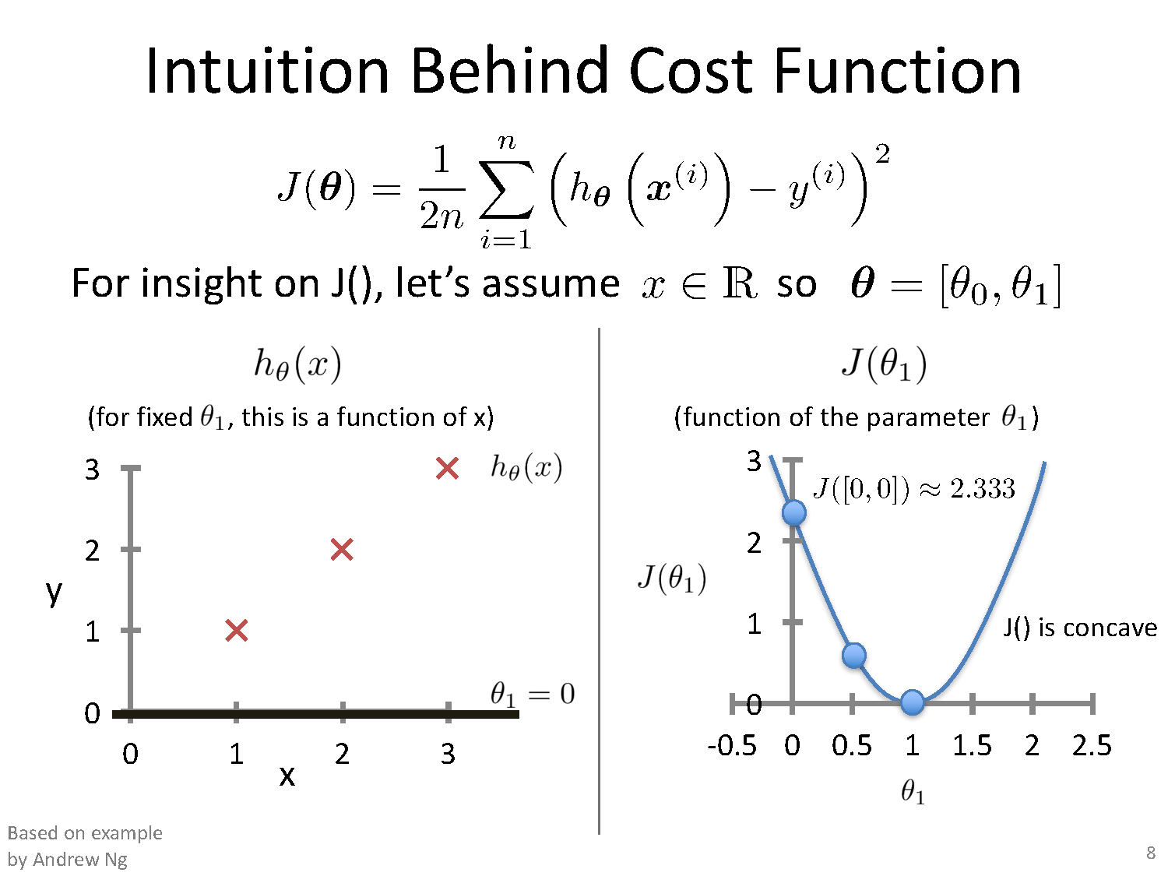

Slide 21
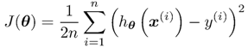
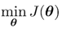
Linear Regression Summary
Hypothesis function →
Parameters to learn → θ_{i}
Cost function →
Goal →

Slide 22
Gradient Descent

Slide 23
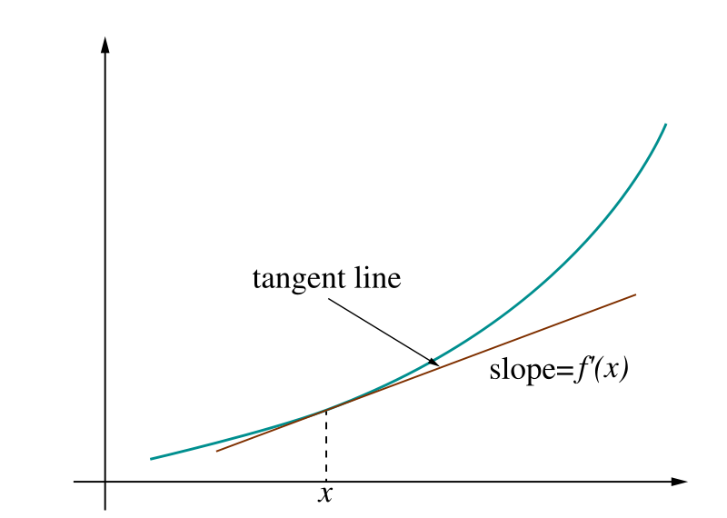
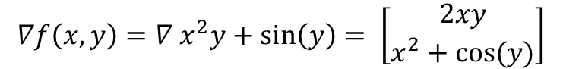
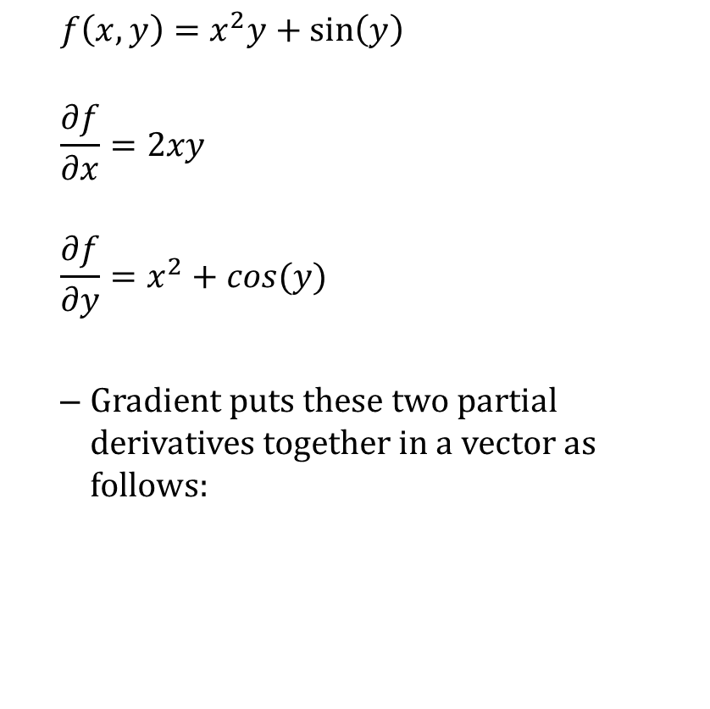
Gradient
$$f\left(x,y\right)=x^{2}y+\sin\left(y\right)$$
$$\frac{∂f}{∂x}=2xy$$
$$\frac{∂f}{∂y}=x^{2}+cos(y)$$
Gradient puts these two partial derivatives together in a vector as follows:
$$∇f\left(x, y\right)=∇ x^{2}y+\sin\left(y\right)= \left[\begin{aligned}2xy \\ x^{2}+cos⁡(y)\end{aligned}\right]$$

Slide 24
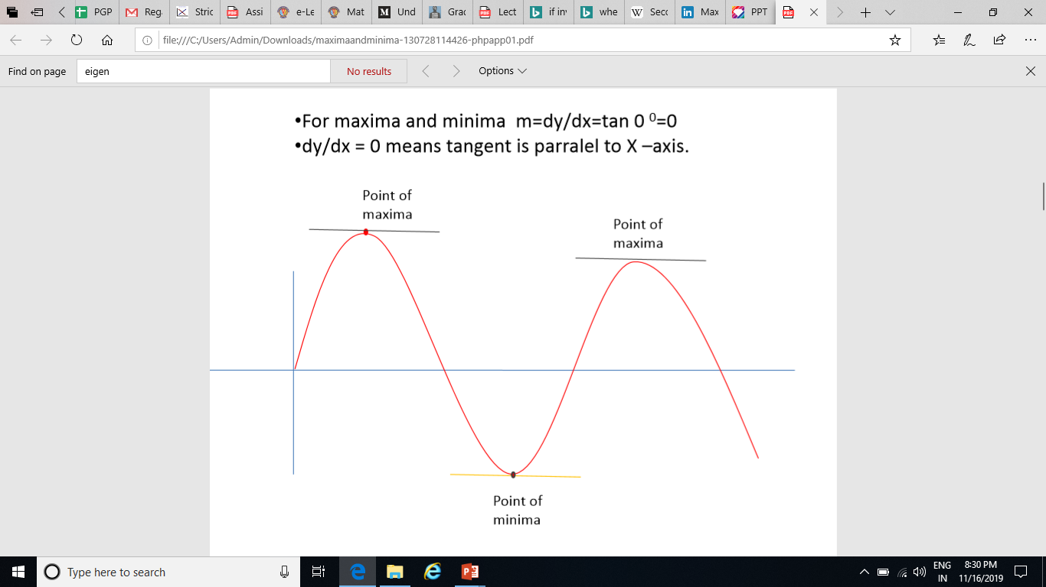
Maxima and Minima

Slide 25
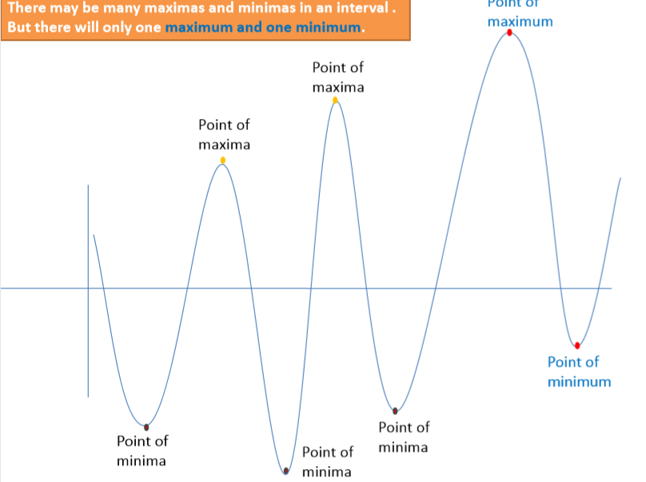
Notion of Maxima and Minima of a function
in Machine Learning
CarPrice = 1 + 0.05Mileage
CarPrice = 1 + 0.25Mileage
CarPrice = 1 + 0.75Mileage
15.7
15.3
Weight of Mileage
Mileage (in kmpl) | Car Price (in cr)
9.8 | 10.48
9.12 | 1.75
9.5 | 6.95
10 | 2.51
12.4
Sum of absolute Error
/ Training Error

Slide 26
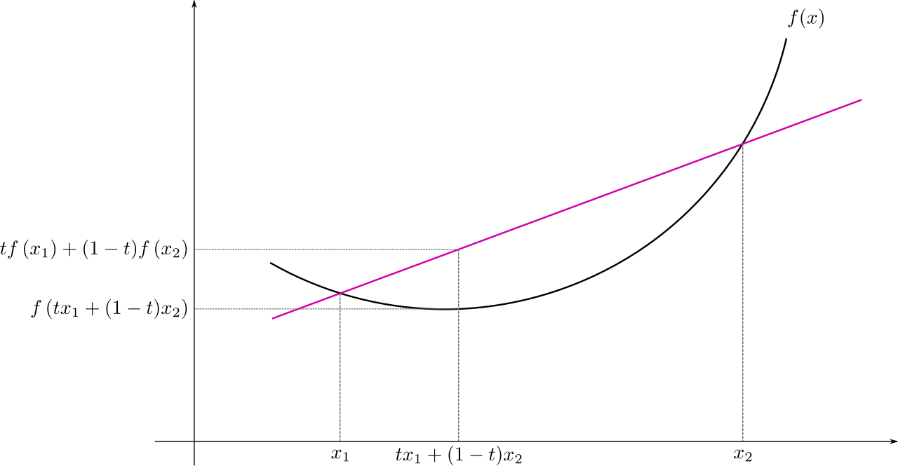
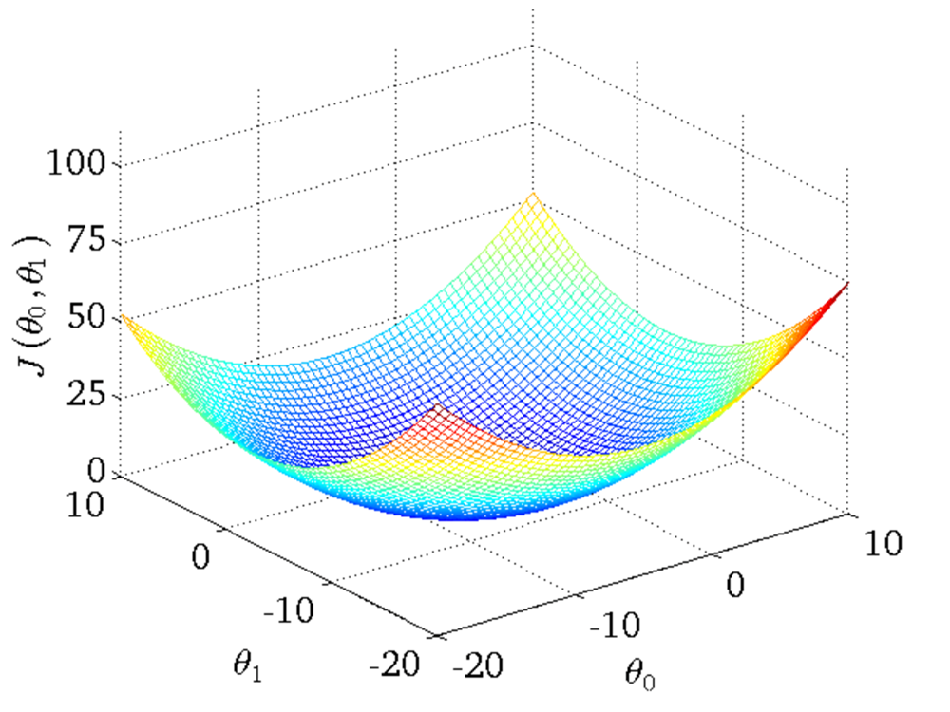
Convex Function
Univariate Multivariate
Real-valued function defined on an n-dimensional interval is called convex if the line segment between any two points on the graph of the function lies above or on the graph

Slide 27
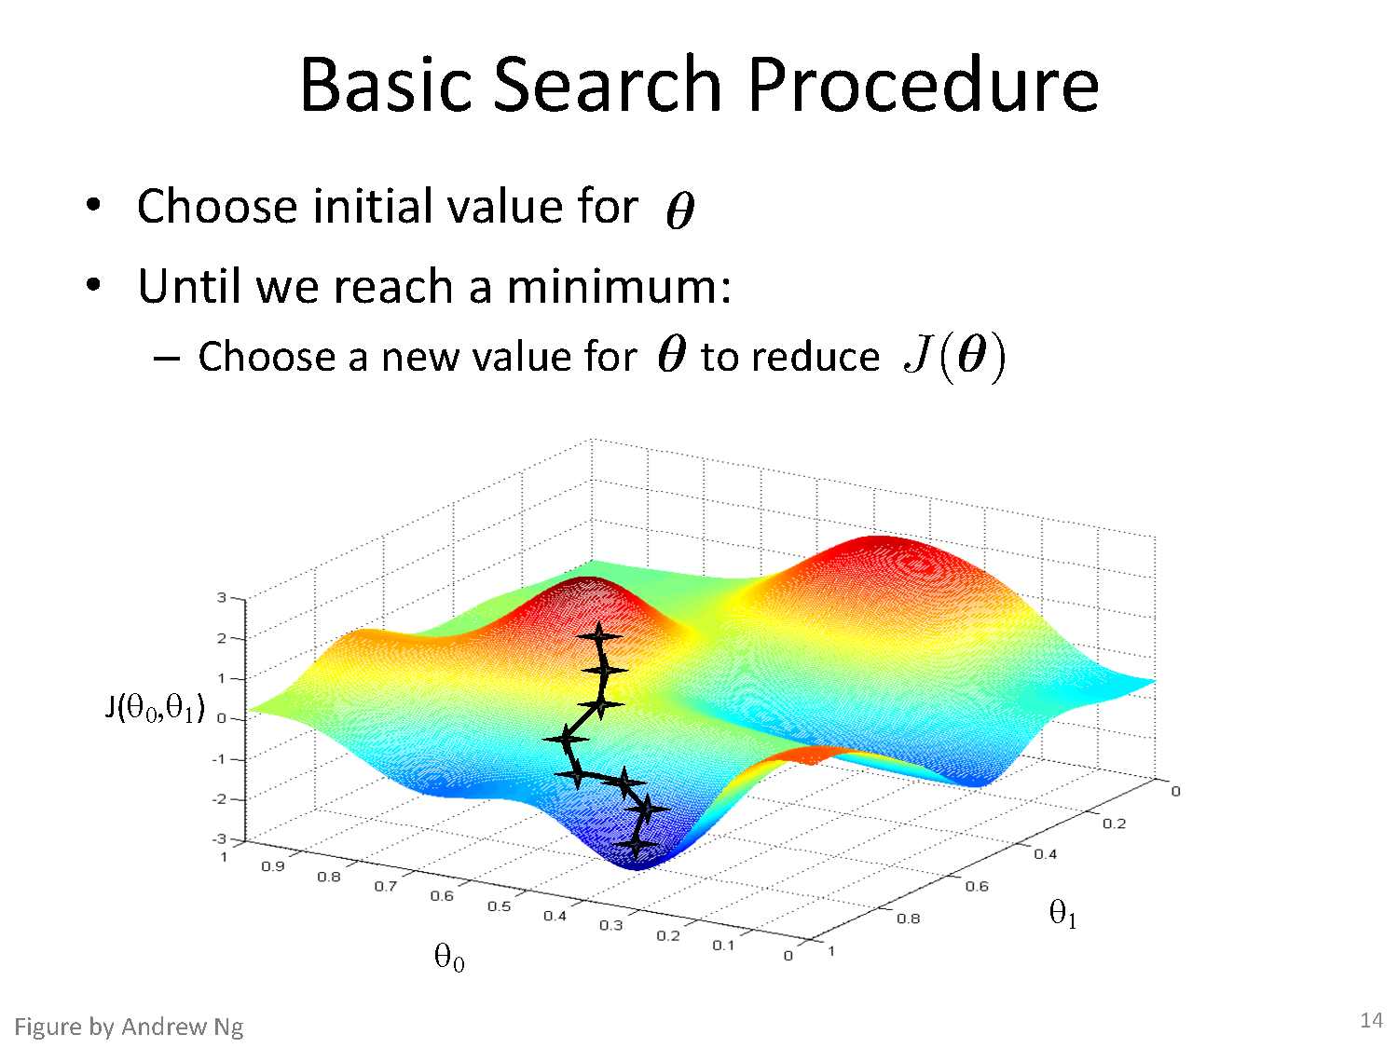

Slide 28
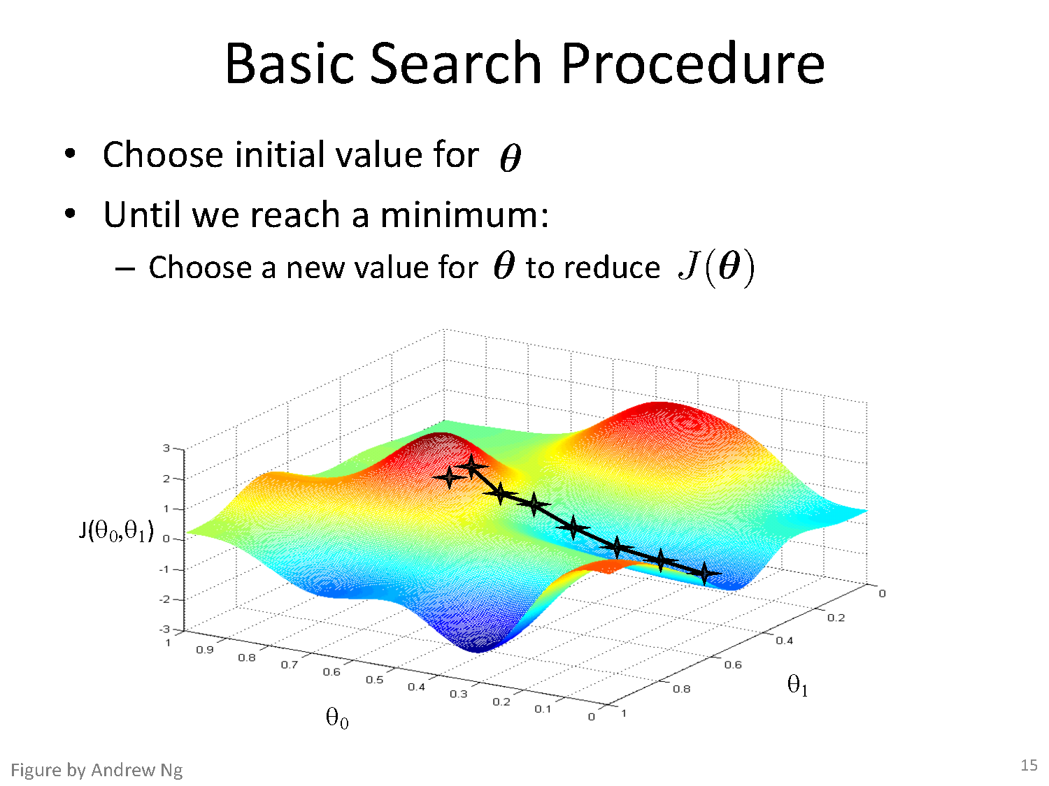

Slide 29
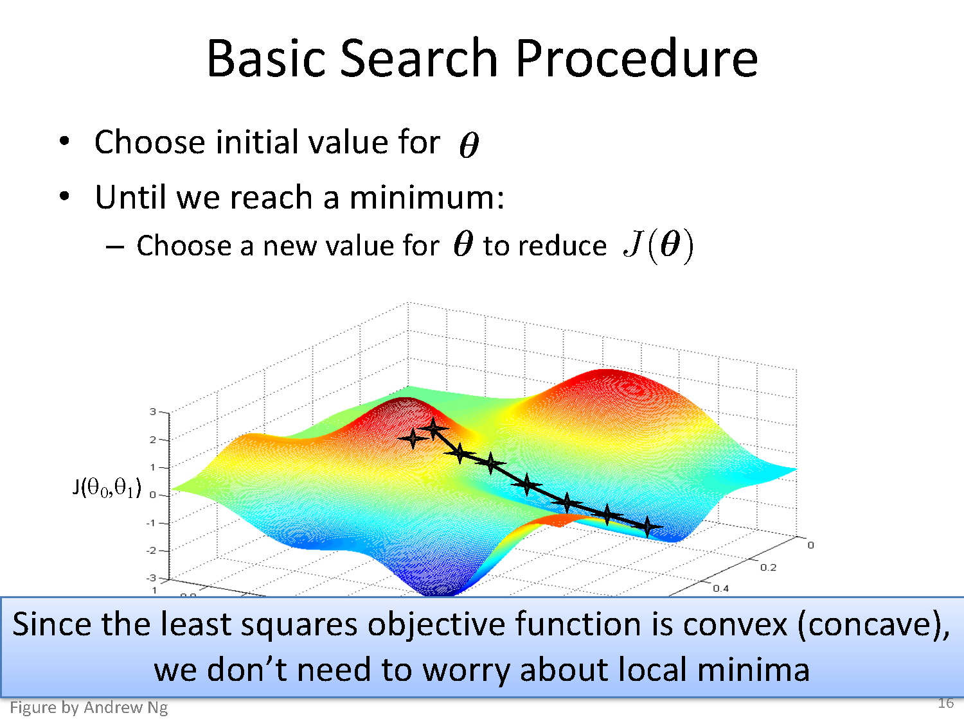

Slide 30
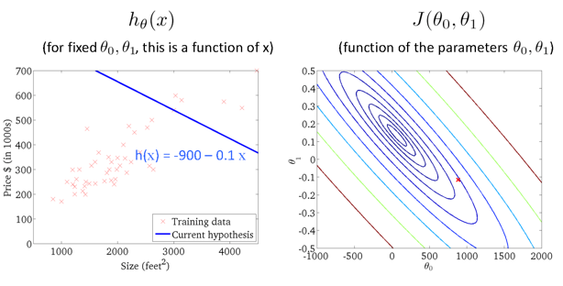
Gradient Descent
Size in feet² (x) | Price ($) in 1000's (y)
2104 | 460
1416 | 232
1534 | 315
852 | 178
… | …
Slide Credit: Andrew Ng

Slide 31
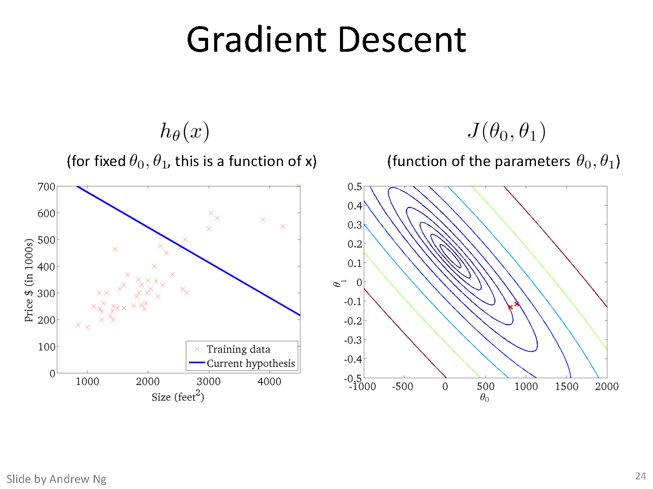

Slide 32
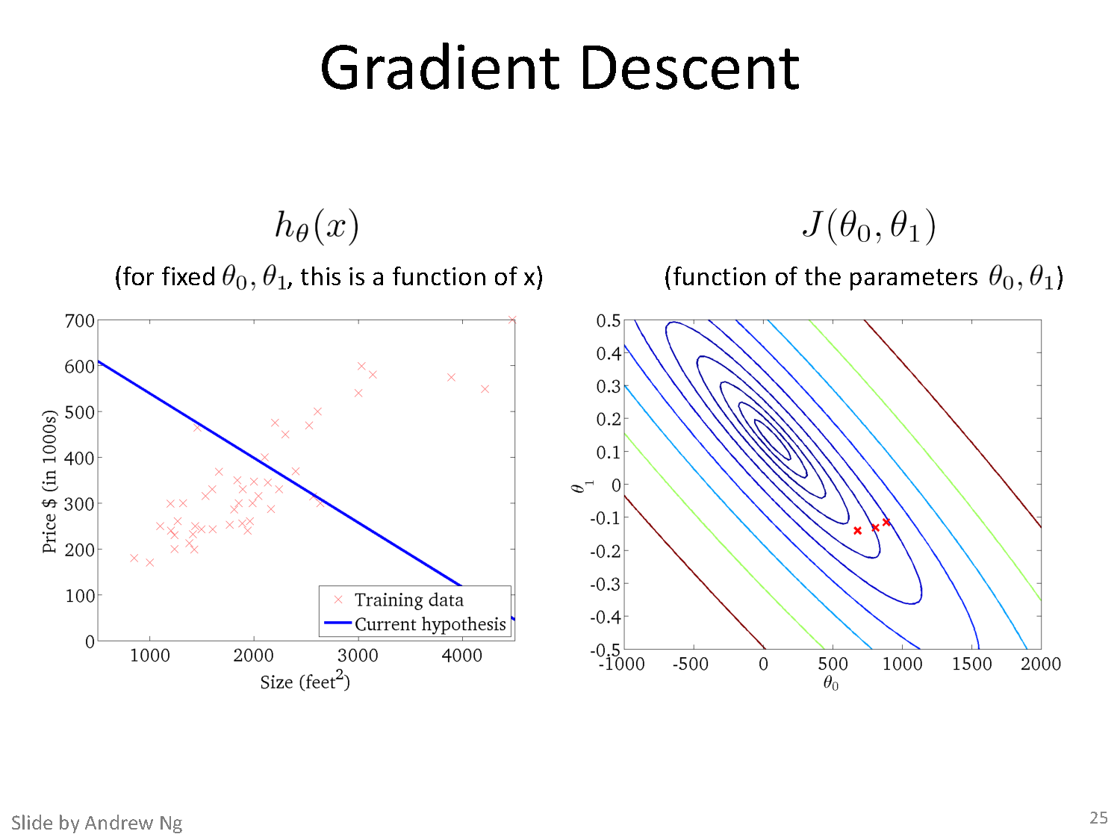

Slide 33
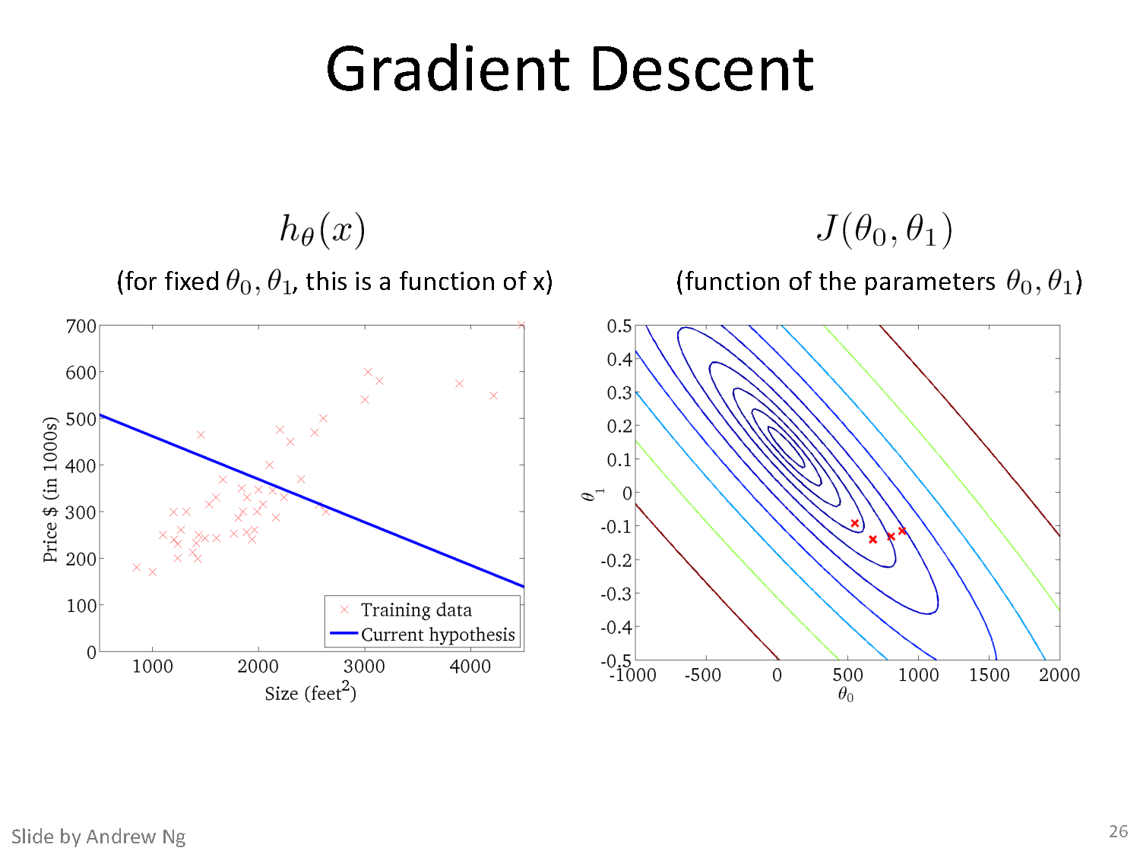

Slide 34
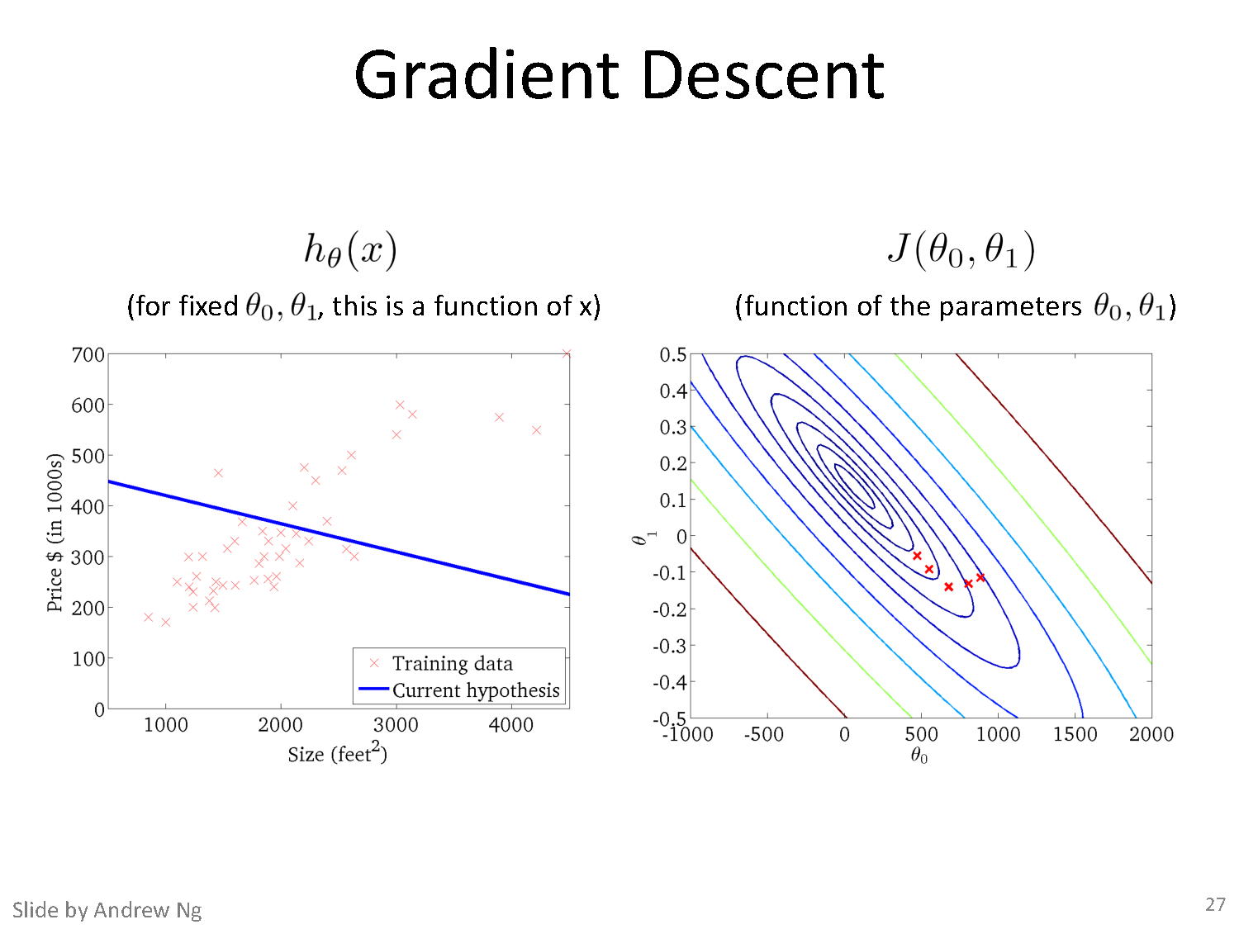

Slide 35
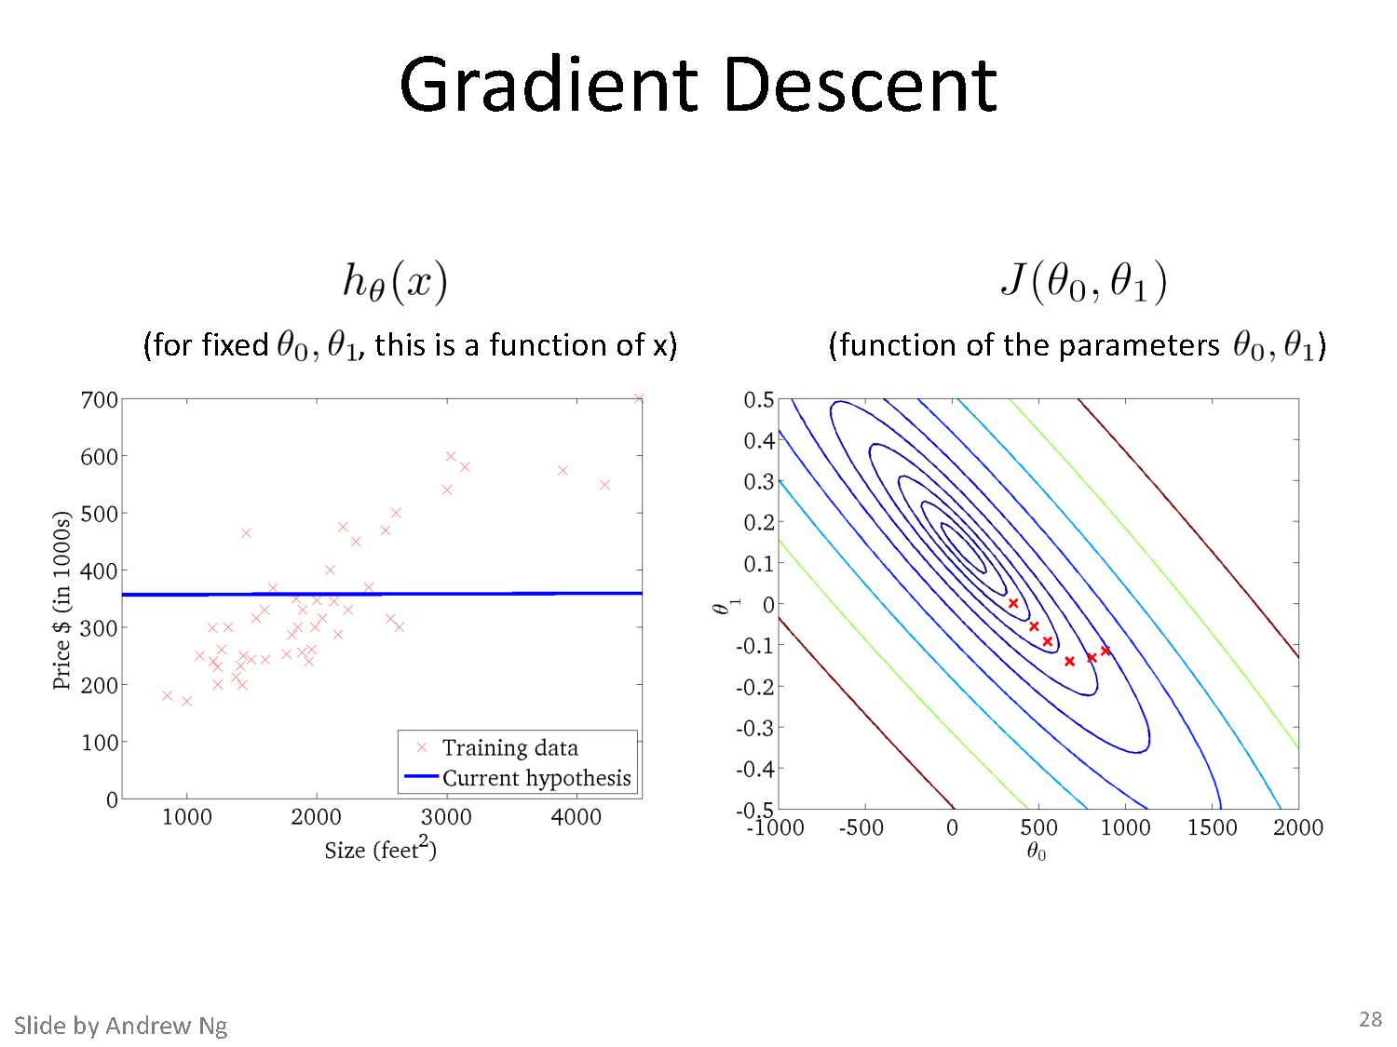

Slide 36
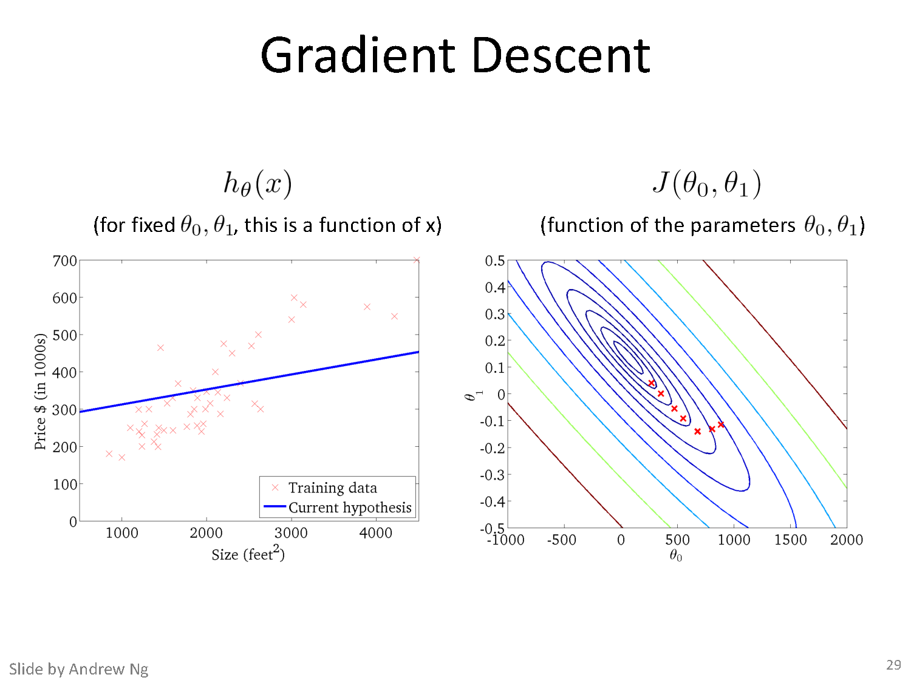

Slide 37
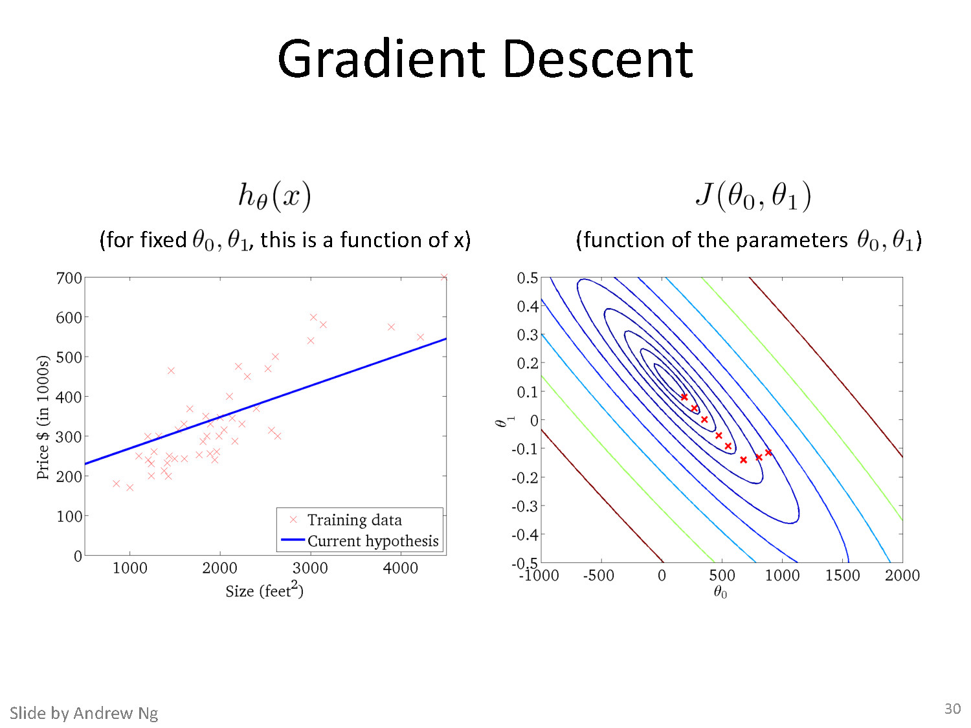

Slide 38
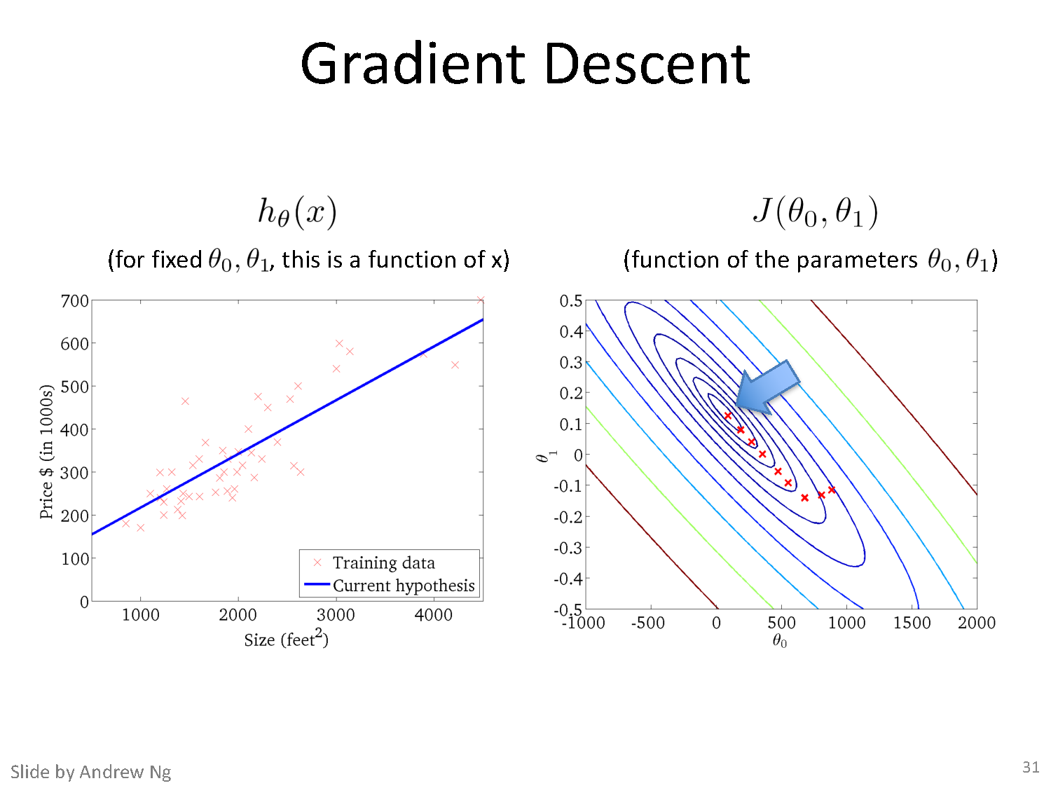

Slide 39
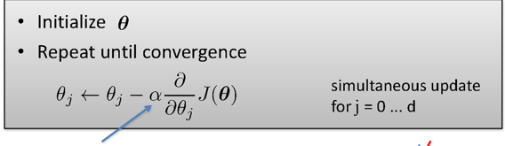
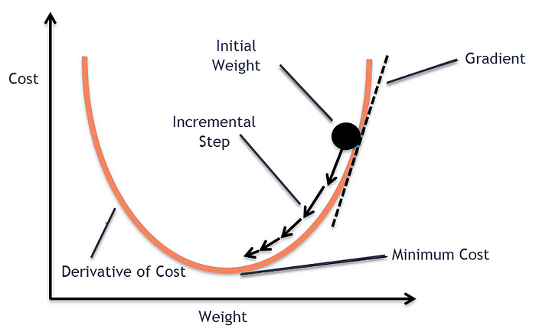

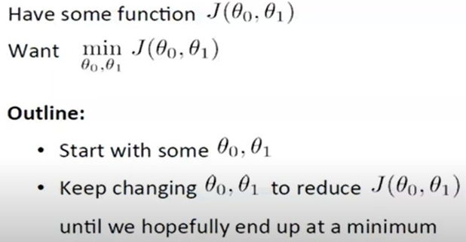
Gradient Descent Algorithm

Slide 41

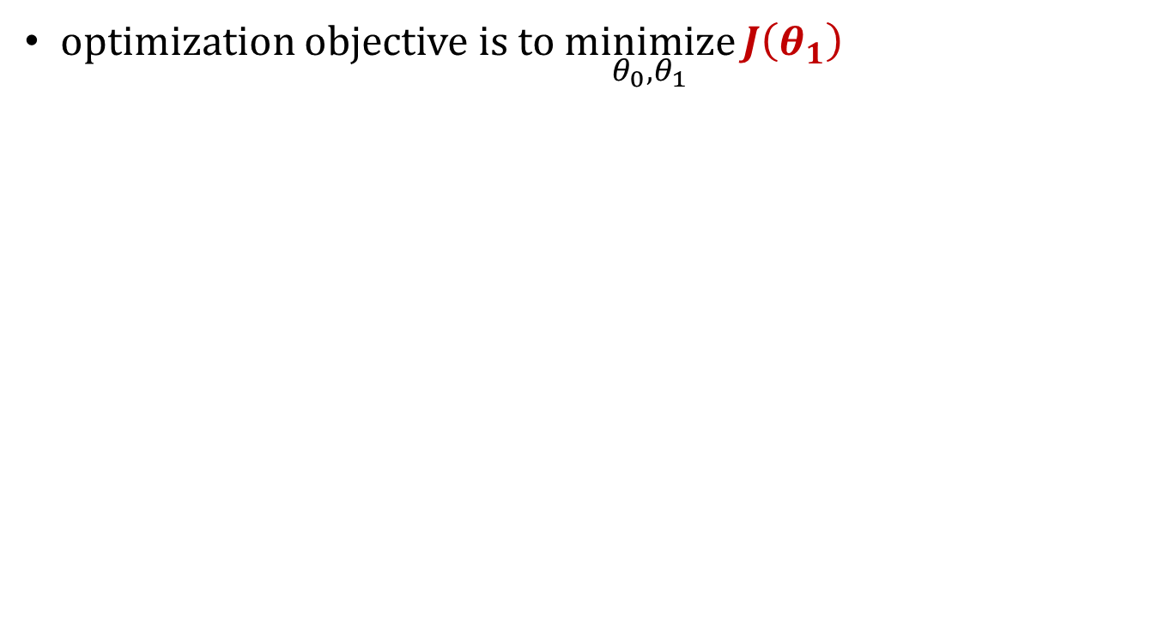
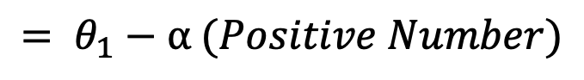

Gradient Descent Intuition
optimization objective is to $\underset{θ_{0},θ_{1}}{minimize}{J\left(θ_{1}\right)}$
$$θ_{1}= θ_{1}−α \frac{d J\left(θ_{1}\right)}{d{ θ}_{j}}$$
$$J$$
$$= θ_{1}−α (Positive Number)$$
Decrease $θ_{1}$ by a certain value
Positive Derivative
𝞱₁
𝞱₁
Credit: Prof. Mohammad Hammoud

Slide 42
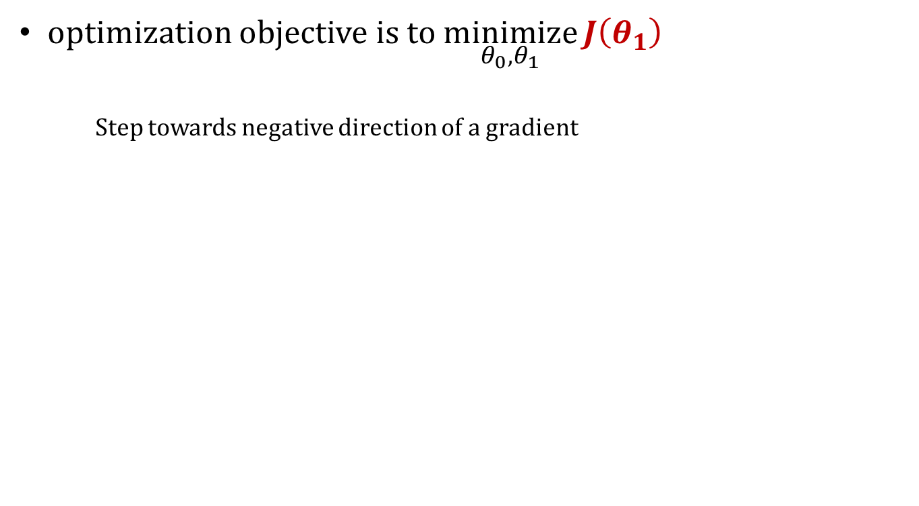
The Impact of Partial Derviative
optimization objective is to $\underset{θ_{0},θ_{1}}{minimize}{J\left(θ_{1}\right)}$
Step towards negative direction of a gradient
$$θ_{1}= θ_{1}−α \frac{d J\left(θ_{1}\right)}{d{ θ}_{j}}$$
$$J$$
$$= θ_{1}−α (Positive Number)$$
Decrease $θ_{1}$ by a certain value
𝞱₁
New 𝞱₁
Old 𝞱₁
Credit: Prof. Mohammad Hammoud

Slide 43



The Impact of Partial Derviative
optimization objective is to $\underset{θ_{0},θ_{1}}{minimize}{J\left(θ_{1}\right)}$
$$θ_{1}= θ_{1}−α \frac{d J\left(θ_{1}\right)}{d{ θ}_{j}}$$
$$J$$
$$= θ_{1}−α (Negative Number)$$
Increase $θ_{1}$ by a certain value
Negative Derivative
𝞱₁
𝞱₁
Credit: Prof. Mohammad Hammoud

Slide 44
The Impact of Partial Derviative
optimization objective is to $\underset{θ_{0},θ_{1}}{minimize}{J\left(θ_{1}\right)}$
$$θ_{1}= θ_{1}−α \frac{d J\left(θ_{1}\right)}{d{ θ}_{j}}$$
$$J$$
$$= θ_{1}−α (Negative Number)$$
Increase $θ_{1}$ by a certain value
𝞱₁
Old 𝞱₁
New 𝞱₁
Credit: Prof. Mohammad Hammoud

Slide 45


The Impact of Partial Derviative
optimization objective is to $\underset{θ_{0},θ_{1}}{minimize}{J\left(θ_{1}\right)}$
$$θ_{1}= θ_{1}−α \frac{d J\left(θ_{1}\right)}{d{ θ}_{j}}$$
$$J$$
$$= θ_{1}−α (Zero)$$
$θ_{1}$ remains the same, hence, gradient descent converges
𝞱₁
Derivative = 0
Credit: Prof. Mohammad Hammoud

Slide 46


The Impact of Learning Rate
optimization objective is to $\underset{θ_{0},θ_{1}}{minimize}{J\left(θ_{1}\right)}$
$$θ_{1}= θ_{1}−α \frac{d J\left(θ_{1}\right)}{d{ θ}_{j}}$$
$$J$$
What happens if $α$ is too small?
Learing Rate
𝞱₁
Credit: Prof. Mohammad Hammoud

Slide 47

The Impact of Learning Rate
optimization objective is to $\underset{θ_{0},θ_{1}}{minimize}{J\left(θ_{1}\right)}$
$$θ_{1}= θ_{1}−α \frac{d J\left(θ_{1}\right)}{d{ θ}_{j}}$$
$$J$$
$$=θ_{1}−(Too Small Number) \frac{d J\left(θ_{1}\right)}{d{ θ}_{j}}$$
$θ_{1}$ changes only a tiny bit on each step, hence, gradient descent will render slow (will take more time to converge)
𝞱₁
Credit: Prof. Mohammad Hammoud

Slide 48


The Impact of Learning Rate
optimization objective is to $\underset{θ_{0},θ_{1}}{minimize}{J\left(θ_{1}\right)}$
$$θ_{1}= θ_{1}−α \frac{d J\left(θ_{1}\right)}{d{ θ}_{j}}$$
$$J$$
$$=θ_{1}−(Too Large Number) \frac{d J\left(θ_{1}\right)}{d{ θ}_{j}}$$
$θ_{1}$ changes a lot (and probably faster) on each step, hence, gradient descent will potentially overshoot the minimum and, accordingly, fail to converge (or even diverge)
𝞱₁
Credit: Prof. Mohammad Hammoud

Slide 49

Gradient Descent algorithm :
Effect of Learning Rate

Slide 50

Gradient Descent algorithm :
Effect of Feature Scaling

Slide 51



Cost Function Linear Regression

Slide 52
Derivative of cost function for one training example

Slide 54

Derivative of cost function for n training example

Slide 55


Gradient Descent for Linear Regression

Slide 56

Gradient Descent for Linear Regression

Slide 57

Gradient Descent: Variants

Slide 58

Gradient Descent: Variants

Slide 59

Gradient Descent: Variants

Slide 60


Gradient Descent: Variants - Effect on Convergence

Slide 61
Fit a linear Regression Line : Gradient Descent
Steps :
(Assuming : ‘n’ no.of.instances and two predictors {x1, x2} and linear regression)
Identification of the equations y = w₀+w₁X₁+W₂X₂
Cost function & derivative
W₀` = w₀ – 1/n * learning rate * (sum (w₀+w₁X₁+W₂X₂ - y))
W₁` = w₁ – 1/n * learning rate * (sum (w₀+w₁X₁+W₂X₂ - y) * x₁)
W₂` = w₂ – 1/n * learning rate * (sum (w₀+w₁X₁+W₂X₂ - y)*x₂)
Apply the equations

Slide 62

Fit a linear Regression Line : Gradient Descent
Fit a linear regression. Show only the first iteration of Gradient descent algorithm using learning rate of 0.02 for the following data , if the Relative Risk of Coronary Heart Disease is believed to be only linearly dependent on BMI as well as Diastolic Pressure. Assume the intercept of the regression model as 5 and the slope of independent variables as -0.03 (negative).

Slide 63

Fit a linear Regression Line : Gradient Descent
Steps :
Identification of the equations: RR-CHD = 5 – 0.03 * BMI – 0.03 * DiastolicPressure
Cost function & derivative
W₀` = w₀ – 1/3 * 0.02 * (sum (5-0.03BMI-0.03DiastolicPresure - RRCHD))
= 5 – 1/3 * 0.02 * (sum (5-0.03BMI-0.03DiastolicPresure - RRCHD))
W₁` = w₁ – 1/3 * 0.02 * (sum (5-0.03BMI-0.03DiastolicPresure - RRCHD) * BMI)
= -0.03 – 1/3 * 0.02 * (sum (5-0.03BMI-0.03DiastolicPresure - RRCHD) * BMI)
W₂ = w₂ – 1/3 * 0.02 * (sum (5-0.03BMI-0.03DiastolicPresure - RRCHD) * DiastolicPresure)
= -0.03 – 1/3 * 0.02 * (sum (5-0.03BMI-0.03DiastolicPresure - RRCHD) * DiastolicPresure)
Apply the equations : Answer at the end of first iteration:
W0 = 5.0016 , W1 = 0.0476, w2= 0.179

Slide 64
References
https://cs229.stanford.edu/lectures-spring2022/main_notes.pdf
Pattern recognition and machine learning, Christopher bishop - CH3

